Slide 1
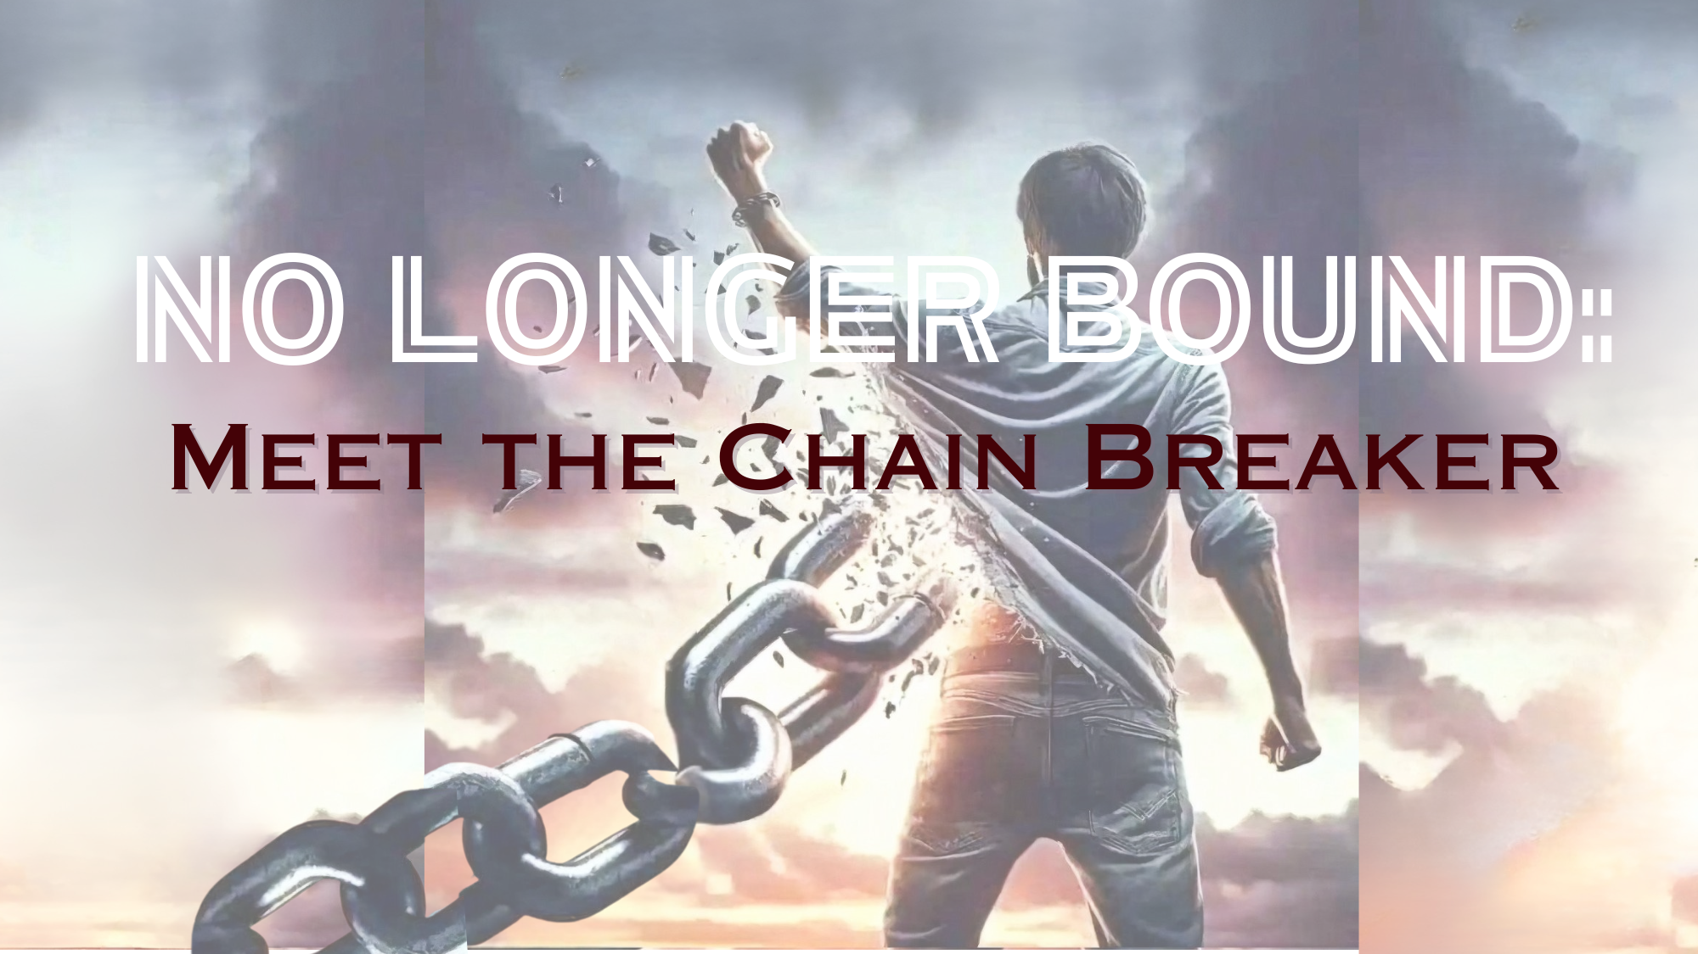

Slide 2

NO LONGER BOUND – HEALING
- YOU ARE A TREASURE!
Breaking Free from the Bondage We Agreed to That Enslaves Our Heart – Jeremiah 40:4,5 & Galatians 5:1.
Many Christians don’t realize that we can make agreements with the enemy of our souls to escape our past pains –whether it be from our performance, relationships, reputation, fear, or loss of control. Even though we have been totally saved from the consequences of our sin, we can still live as a slave to Satan himself because of conscious and unconscious contractual agreements we have made in our hearts.
God wants us FREE to live life as He designed it. To do so we must look inside our hearts, uncover these old agreements, and discover the simple steps to revoke and break them.
By breaking these oppressive agreements, we can then freely live out the life
Jesus ransomed us for and become fully alive through the four tributaries of Discipleship, Counseling, Healing, and Warfare.
God is calling us to live out our calling in communities of the heart, to fight for one another and for the hearts of those who have not yet been set free!
Notes:
Conscious or unconscious.

Slide 3
NO LONGER BOUND:
THE REALITY of WAR!
– Isaiah 52:1-2.
EPIC BATTLE → The heart of Satan is to hinder and harm and ruin God’s image bearer. The story of your life is the story of the long and brutal assault on your heart by the one who knows what you could be and fears it. Things are not what they seem. We are at war (Isaiah 61:1). To live in ignorance of spiritual warfare is the most naïve and dangerous thing a person can do! You must fight for your heart!
AGREEMENTS → The plan of Satan is to oppose any movement toward freedom and life, any movement toward God or others. Marriage, friendship, beauty, rest—the thief wants it all. Make NO AGREEMENTS! Believe the TRUTH!
RELIGIOUS SPIRIT → Makes it next to impossible for a person to break free by spreading the lie that there is no war. Most men don’t even know they can walk with God, hear His voice.

Slide 4

NO LONGER BOUND: FREEDOM!
– Isaiah 49:24-26.
FIERCE MASTERY → God appoints us as the governors of His domain. We were meant to rule, as he—the God of angel armies-–rules (Gen. 1:26-28). This could get fierce (Luke 10:3).
Three Big Ideas:
  Enemy is Real → There is a brutal assault on your heart.
  Agreements → Satan is trying to get you to agree with him.
  War → You must fight!
Notes:
We want to be as clear as possible what we mean by an “agreement.” Satan is a liar, “the father of lies” (John 8:44), so utterly convincing he deceived a glorious man and woman to betray God, whom they walked with every day. I think we tend to dismiss Adam and Eve as the idiots who got us all into this mess in the first place. But they had not yet sinned; they had experienced no wounding; they were man and woman in their glory. And they were deceived. It ought to give us all a healthy respect for what the enemy is capable of. (Genesis 3:9-13).

Slide 5
NO LONGER BOUND: FOUR RIVERS TO FREEDOM! Our mission is to free the captives as agents of God’s army!
Walk with God → Trust God! (Proverbs 4:18, 19 & Psalm 25:4).
Counseling → Listen to a man’s story, hear where he is wounded, how he has mishandled the wounds, and where the Enemy has probably come in.
Deep Healing → Childhood vows (TRAUMA) are very dangerous things; they act as agreements with the Enemy, give him permission to enter some part of our lives.
Warfare → In the name of Jesus, we must command the evil one to release the captive.
Notes:
We want to be as clear as possible what we mean by an “agreement.” Satan is a liar, “the father of lies” (John 8:44), so utterly convincing he deceived a glorious man and woman to betray God, whom they walked with every day. I think we tend to dismiss Adam and Eve as the idiots who got us all into this mess in the first place. But they had not yet sinned; they had experienced no wounding; they were man and woman in their glory. And they were deceived. It ought to give us all a healthy respect for what the enemy is capable of. (Genesis 3:9-13).

Slide 6
ACTION: Journal This!
Who really cares about you?
How do you demonstrate care and value for yourself?
How is self-care an act of war against the Enemy?

